Slide 1

INSTITUTE - UIE
DEPARTMENT- ACADEMIC UNIT-2
Bachelor of Engineering (Computer Science & Engineering)
Subject Name: Introduction to Problem Solving
Subject Code: 22CSH-101
Memory layout of C Program
DISCOVER . LEARN . EMPOWER

Slide 2


Introduction to Problem Solving
Course Objectives
The course aims to provide exposure to problem-solving through programming.
The course aims to raise the programming skills of students via logic building capability.
With knowledge of C programming language, students would be able to model real world problems.

Slide 3



Course Outcomes
CO Number | Course Outcome
CO1 | Remember the concepts related to fundamentals of C language, draw flowcharts and write algorithm/pseudocode.
CO2 | Understand the way of execution and debug programs in C language.
CO3 | Apply various constructs, loops, functions to solve mathematical and scientific problem.
CO4 | Analyze the dynamic behavior of memory by the use of pointers.
CO5 | Design and develop modular programs for real world problems using control structure and selection structure.

Slide 4
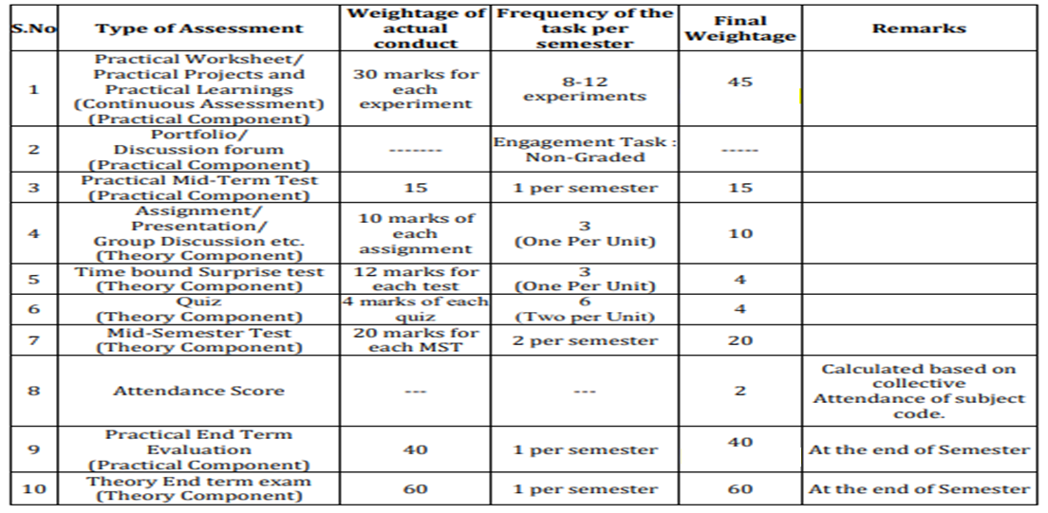
Scheme of Evaluation

Slide 5
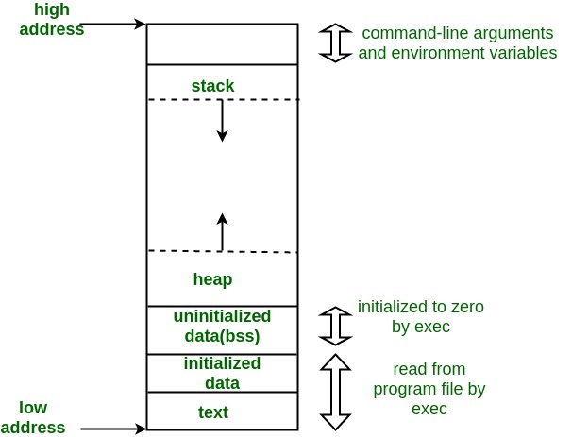
Memory Layout of C program
Memory Layout of C Programs
A typical memory representation of C program consists of following sections.
1. Text segment 2. Initialized data segment 3. Uninitialized data segment 4. Stack 5. Heap

Slide 6
Memory Layout of C program contd…
Stack The process Stack contains the temporary data such as method/function parameters, return address and local variables. It is an area of memory allotted for automatic variables and function parameters. It also stores a return address while executing function calls. Stack uses LIFO (Last- In-First-Out) mechanism for storing local or automatic variables, function parameters and storing next address or return address. The return address refers to the address to return after completion of function execution. This segment size is variable as per local variables, function parameters, and function calls. This segment grows from a higher address to a lower address.

Slide 7
Memory Layout of C program contd…
Heap This is dynamically allocated memory to a process during its run time. This is area of memory allotted for dynamic memory storage such as for malloc() and calloc() calls. This segment size is also variable as per user allocation. This segment grows from a lower address to a higher address.

Slide 8
Memory Layout of C program contd…
Text This includes the current activity represented by the value of Program Counter and the contents of the processor's registers. It is represented by .text section. This defines an area in memory that stores the instruction codes. This is also a fixed area.

Slide 9
Memory Layout of C program contd…
Data This section contains the global and static variables. It is represented by .data section and the .bss. The .data section is used to declare the memory region, where data elements are stored for the program. This section cannot be expanded after the data elements are declared, and it remains static throughout the program. The .bss section is also a static memory section that contains buffers for data to be declared later in the program. This buffer memory is zero-filled.

Slide 10
Memory Layout of C program contd…
Initialized data segment This is a portion of the object file or program’s virtual address space that consists of uninitialized static and global variables. Un-initialized data segment is also called BSS (Block Started by Symbol) segment.
Un-initialized data segment This is read-write, since the values of variables could be changed during run time. This segment also has a fixed size.

Slide 11

REFERENCES
Reference Books:
[1] Programming in C by Reema Thareja.
[2] Programming in ANSI C by E. Balaguruswamy, Tata McGraw Hill.
[3] Programming with C (Schaum's Outline Series) by Byron Gottfried Jitender Chhabra, Tata McGraw Hill.
[4] The C Programming Language by Brian W. Kernighan, Dennis Ritchie, Pearson education.
Websites:
https://www.tutorialandexample.com/block-diagram-of-a-computer/
https://www.tutorialspoint.com/computer_fundamentals/computer_memory.htm
https://www.geeksforgeeks.org/memory-layout-of-c-program/
YouTube Links:
https://www.youtube.com/watch?v=1owWbDQ5dJQ
https://www.youtube.com/watch?v=v9e2gaUwKf4
https://www.youtube.com/watch?v=kpWG423uQIw

Slide 12
THANK YOU

